Slide 1
MATLAB Programming
Assignment Three
Curve Animation & Image
Instructor: 黃世強 (Sai-Keung Wong)

Slide 2
Marking Scheme
Program 1: 30%
Program 2: 35%
Program 3: 35%

Slide 3
About the demo video
A demo video may have bugs. The demo video shows roughly the results. These results may not be exactly the same as the requirements. They are for your own reference. You must follow the instruction to finish your programs.

Slide 4
Program file name format
Write all your programs in a folder. The folder name is hw03_student_ID.
Zip the folder and upload it.
Write a program for each problem in one file.
The file name is hw03_X_yourStudentID.m, where X is the problem number.
For example, if your student ID is 12345678 and the problem number is 3, then the file name must be hw03_3_12345678.m.
You must not output all the intermediate results.
If your program cannot run interactively, some points will be deducted from your program.
Output the results that are required only.

Slide 5
A Warm Reminder
For each problem, display the problem number before showing the results.
clf; clear; clc; % clear the current figure
% clear variables, and clear screen
disp(‘Assignment Problem 3.1’) % show Assignment Problem 3.1

Slide 6
Program Header
At the top of the file, write down your name, ID, email address, department, and date.
%%%%%%%%%%%%%%%%%%%%%%%%%%%
% Assignment Number: …
% Problem number: …
% Student Name: …
% Student ID: …
% Email address: …
% Department:
% Date: ….
%%%%%%%%%%%%%%%%%%%%%%%%%%%%

Slide 7
Example
Given two pairs of functions:
y1(x) = x, y2(x) = ( x² +2 )/ (|x|+1)
z1(x) = sin(x) + 1, z2(x) = cos(x)
Interpolate linearly the two functions of each pair.
e.g., y(x) = k y1(x) + (1-k) y2(x),
Animate the interpolation process by changing k from 1 to 0, with decrement 0.01. Pause for 1/30 second per step.
Show the result on the same figure. Each pair of functions is shown in a subregion. The original functions must also be plotted.
Beautify the figure. x in [-10, 10]

Slide 8
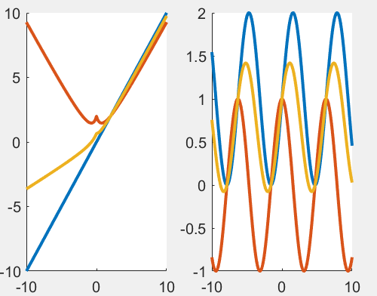
Example
Given two pairs of functions:
y1(x) = x, y2(x) = ( x² +2 )/ (|x|+1)
z1(x) = sin(x) + 1, z2(x) = cos(x)
Interpolate linearly the two functions of each pair.
e.g., y(x) = k y1(x) + (1-k) y2(x),

Slide 9
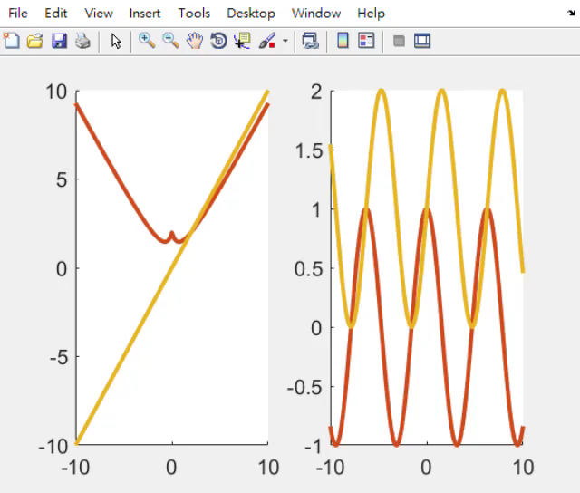
Example

Slide 10
Problem 3.1.
Given two functions
y1(x) = sin(5x) + 5, y2(x) = 2cos(x²) – 5
z1(x) = x*sin(x/2) + 5, z2(x) = 2cos(x²)/(sin(x)+1.5) - 1
Interpolate linearly the two functions of each pair.
e.g., y(x) = k y1(x) + (1-k) y2(x).
Animate the interpolation process by changing k from 1 to 0, with decrement 0.01. Pause for 1/30 second per step.
Show the result on the same figure. Each pair of functions is shown in a subregion. The original functions must also be plotted.
Set the font size properly. x in [-10, 10]

Slide 11
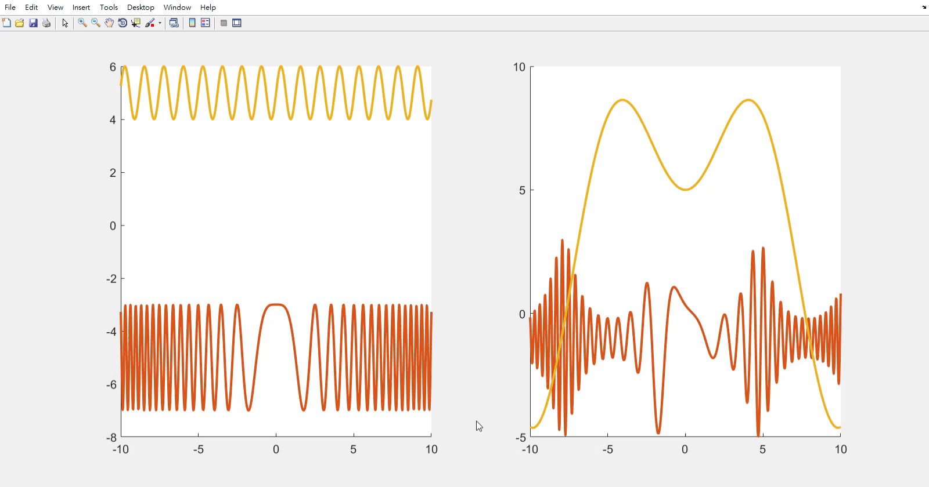
Problem 3.1.

Slide 12
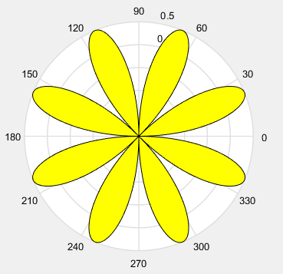
Problem 3.2.
x = 0:0.01:pi*2;
r = cos(2x)sin(2x);
The program draws a figure on the right.
Write a program to trace the curve by changing x in the interval. Fill the region(s) while the curve is being drawn.

Slide 13
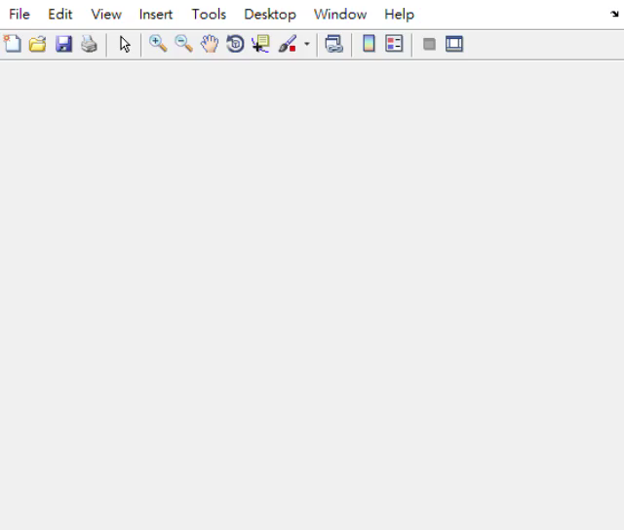
Problem 3.2.

Slide 14
Problem 3.3. An Interactive System
This program manipulates the image, tmp.png. Resize the image to [320 320]. The program should be implemented using a loop-structure. Don’t quit the program until option 0 is selected. A spot light is represented as a disk with a radius r. r is inside [20, w]. Show the options:
0) Show student name and ID. Then quit the program.
1) Turn on or off a spot light at the center of the image.
2) Turn on or off a spot light at the right side of the image.
n) Press ‘n’ to reduce the radius of the disk. Each time, reduce r by 20.
m) Press ‘m’ to increase the radius of the disk. Each time, increase r by 20.
Initially, the radius of the disk is w/2, where w is the width of the image.
Raise or reduce the intensities of pixels in a circular disk (i.e., filled circle) at the spot light based on whether the spotlight is on or off, respectively. If the spot light is on, it is off next time.

Slide 15
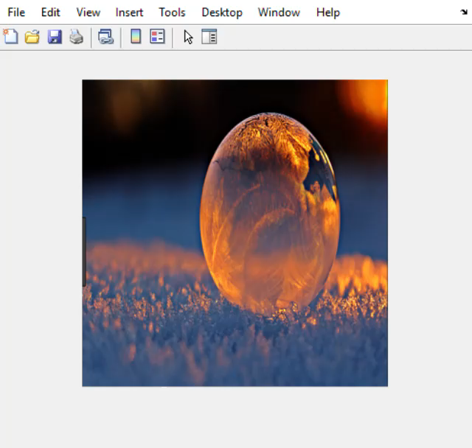
Problem 3.3
Play the video

Slide 16
An Example to handle key events
We need to handle key events in our program(s).
A key event occurs when a key of the keyboard is pressed or released.
We will use key pressed events to interact with our programs.
Please run the program in the folder HowToUseKeyEventCallback to see how a program can handle key events.
Read m_KeyCallBack_image to see which keys you should press.

Slide 17
Enable a figure to receive key pressed events
Mainly, we hold the handle of a figure, e.g., h_fig, in this case.
After that use function set to set the function m_KeyCallBack_image to handle the key events
set(h_fig,'KeyPressFcn',...
@m_KeyCallBack_image); % callback function
Please read information about 'KeyPressFcn‘
Please read the function m_KeyCallBack_image on your own.

Slide 18
End
Enjoy MATLAB Programming.

